Slide 1
Convolutional neural network(Convnet, cnn)
Ali Cenk Baytop

Slide 2
Content
- Fundamentals of Image
- Fundamentals of Artificial Neural Network
- Why CNN?
- History of Convolutional Neural Network
- Applications of CNN
- Architecture of Convolutional Neural Network

Slide 3
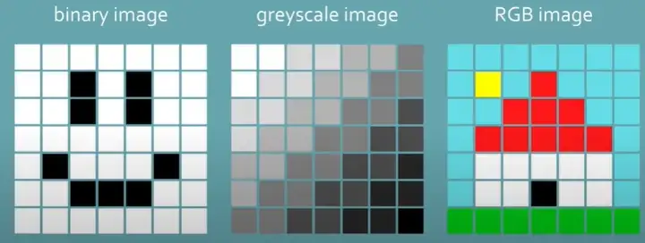
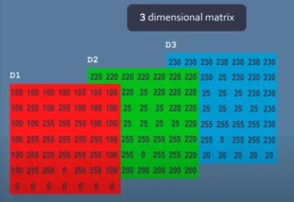
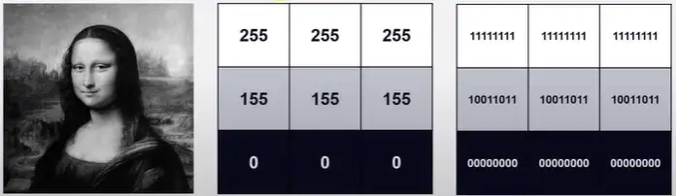

Fundamentals of Image
- Pixel
- Color
- Digital image formats(png, jpeg, gif, bmp, etc,)
- 8 bits
- Back-to-back

Slide 4
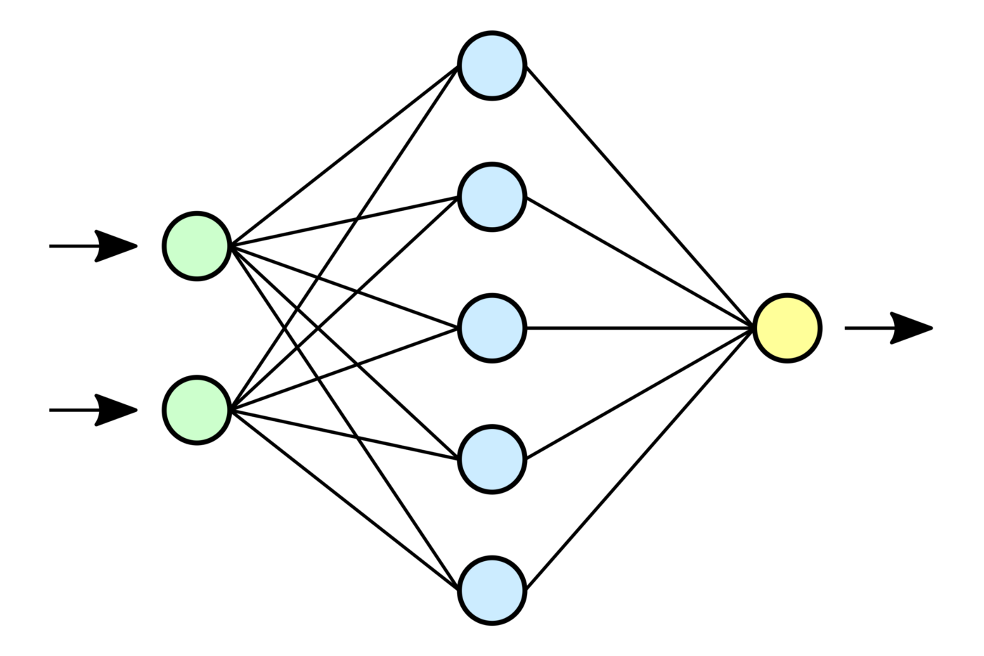
Fundamentals of Neural Network

Slide 5
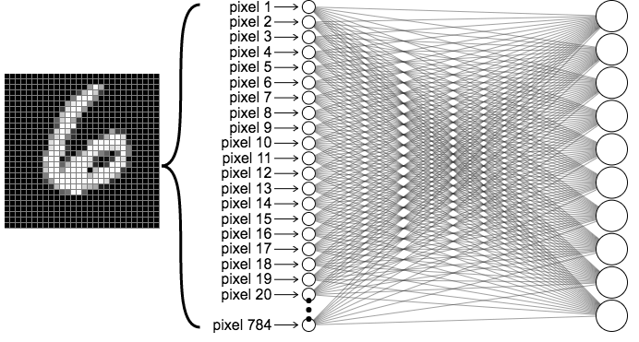
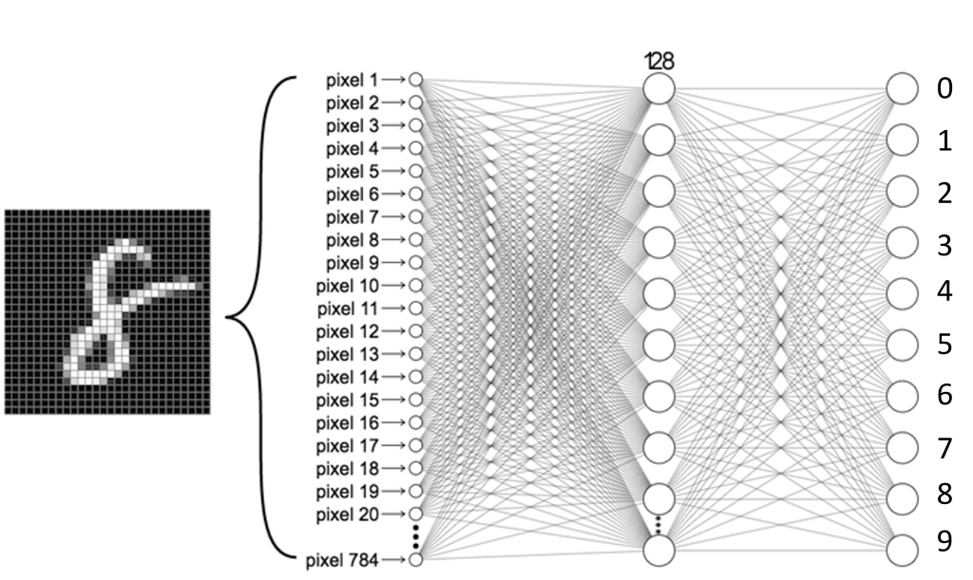
Mnist HANDWITTEN DIGITS dATASET
- Image size 28x28
- Sample size 70.000 images(60k train, 10k test)
- MNIST handwritten digit database, Yann LeCun, Corinna Cortes and Chris Burges

Slide 6
why CNN?
- Local Connectivity: They consider the context/shared information in the small neighborhoods. Important especially for images. Filter
- Shared Weights: This is the concept that makes CNNs "convolutional." By forcing the neurons of one layer to share weights, the forward pass (feeding data through the network) becomes the equivalent of convolving a filter over the image to produce a new image. Feature map
- Pooling and Activation: They reduce the number of units/

Slide 7
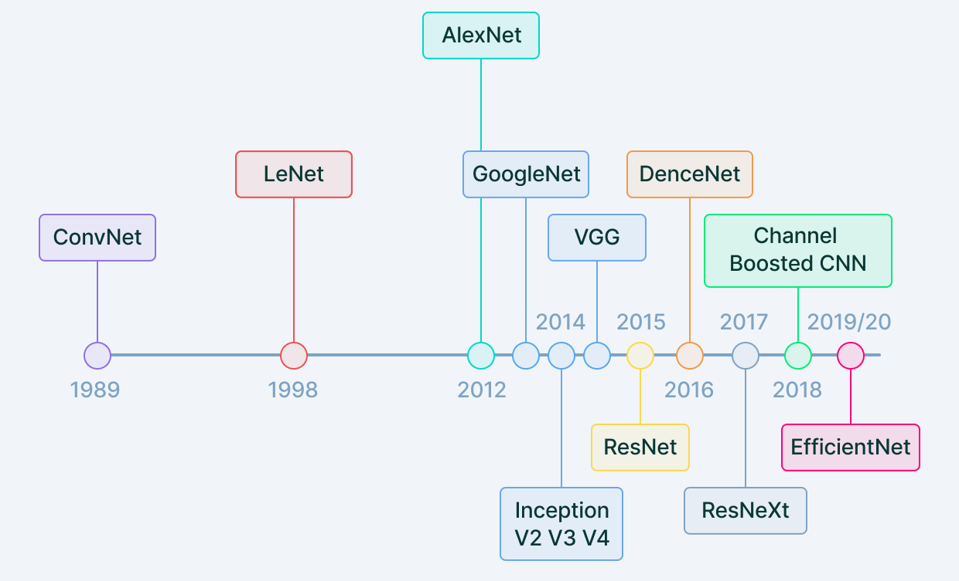
History of Convolutional Neural Network
- Gradient-Based Learning Applied to Document Recognition(Yann Lecunn, 1998) LeNet-5
- Alex Krizhevsky, ImageNet competition, 2012, AlexNet

Slide 8
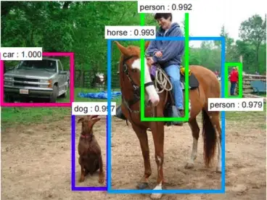
Where do we use CNN?
- Image recognition
- Video analysis
- Document analysis
- Natural language processing
- Anomaly detection
- Object detection
- etc.

Slide 9
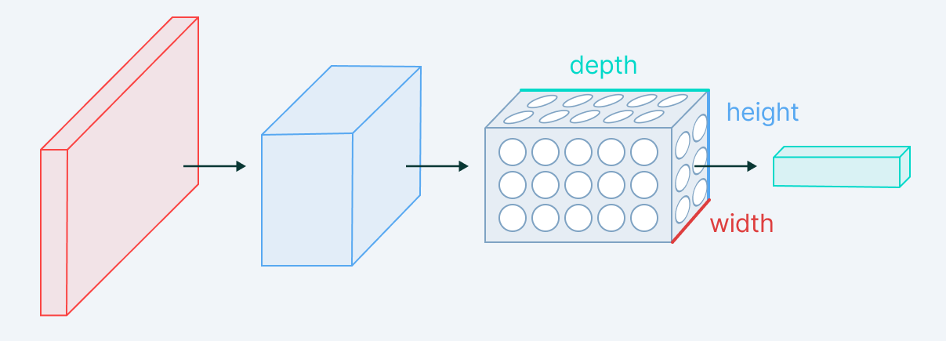
Architecture of Convolutional Neural Network
- Input Layer
- Convolutional Layer
- Pooling Layer
- Activation Layer
- Fully-Connected Layer

Slide 10
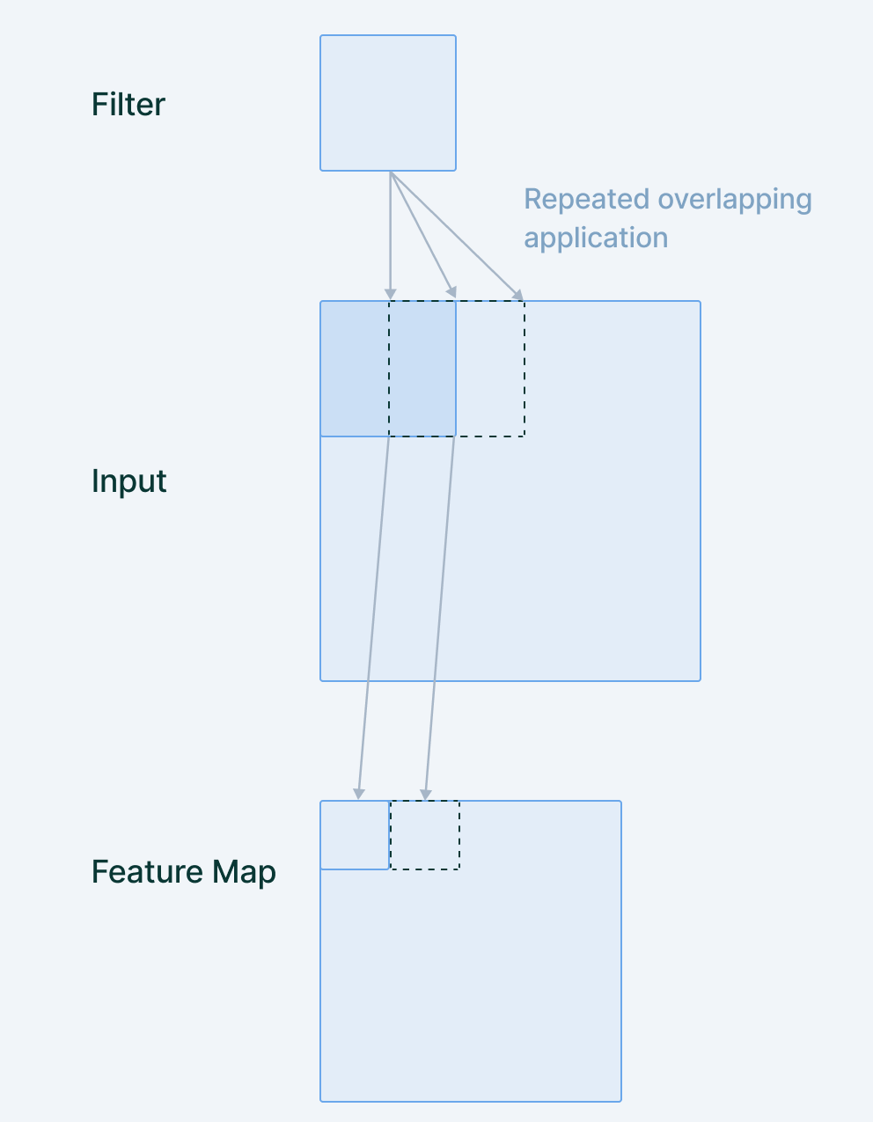
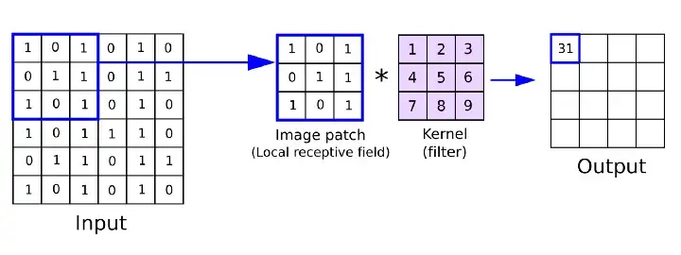
ConvolutIon layer and feature mappIng
- Convolution neural networks can learn from multiple features parallelly.
- Depth

Slide 11
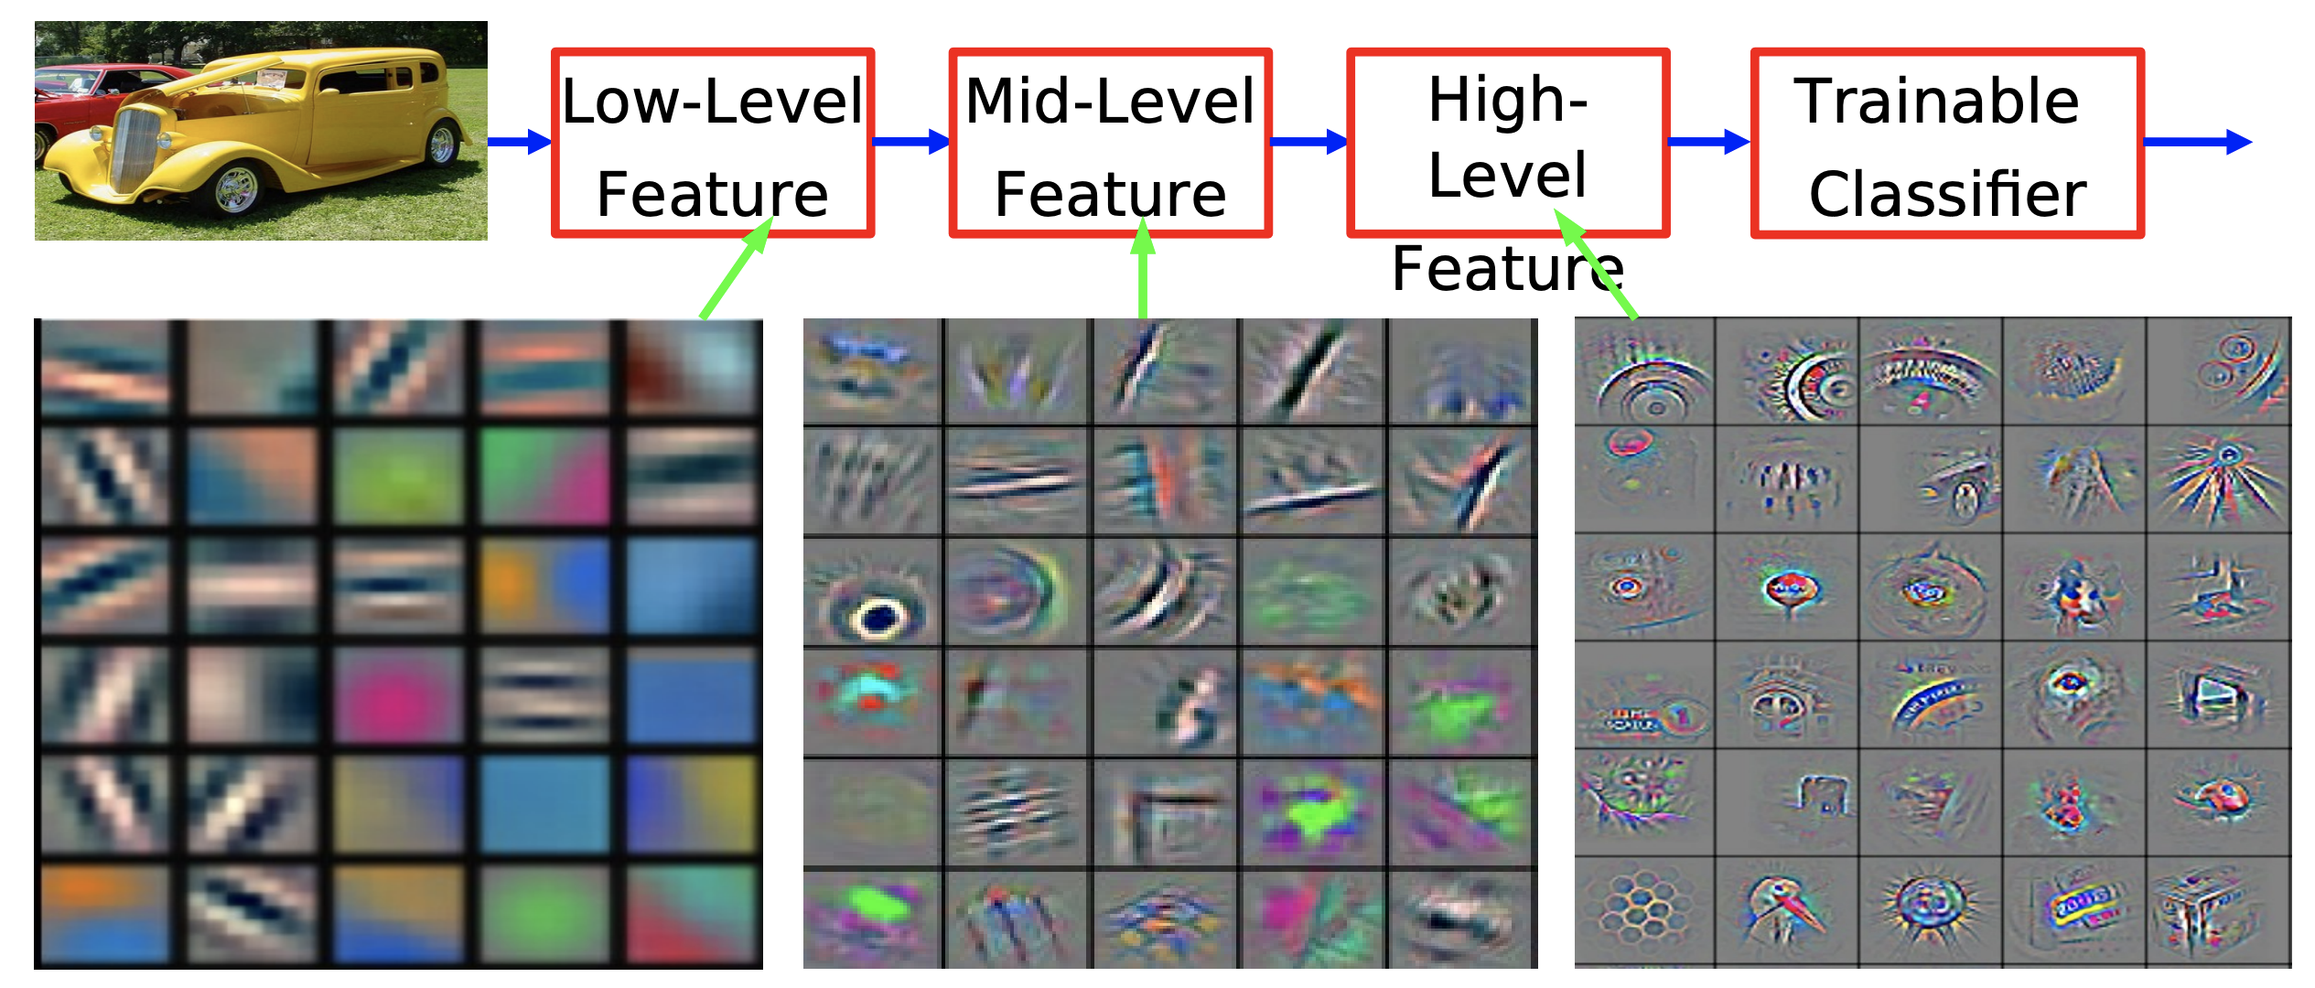

Slide 12
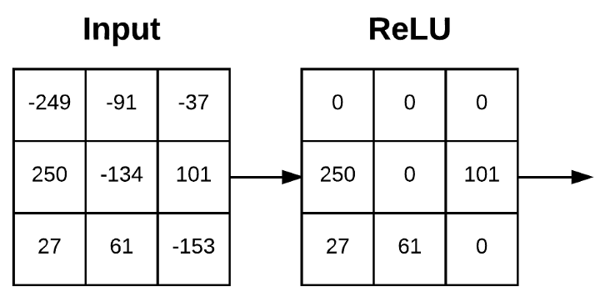
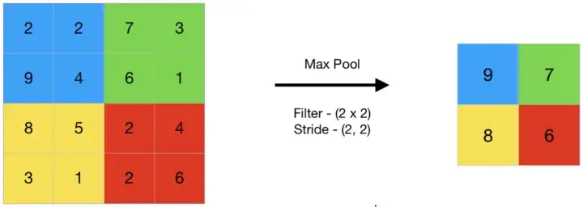
poolIng AND ACTIVATION LAYERS

Slide 13
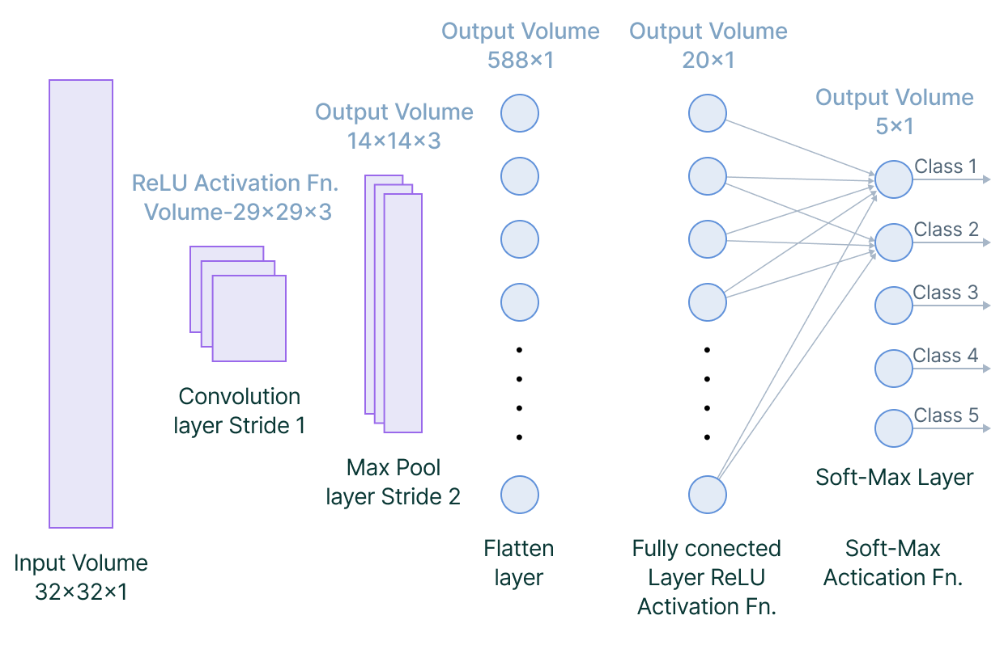
Fully-Connected Layer

Slide 14


Slide 15
- About loss layer (then Cost Function depends on it fine tuning and same steps).

Slide 16


Slide 17
THANK YOU
Ali Cenk Baytop
https://tr.linkedin.com/in/alicenkbaytop
https://medium.com/@alicenkbaytop

